Slide 1
City Transportation Analysis
Emile & Warren

Slide 2
The issue at hand
The availability of public transportation in New York City can often seem unbalanced, especially if you look at the outer boroughs like Brooklyn and Queens.
Even beyond service issues and delays, there are just some areas of the city that are very “dry” in terms of transportation, whether it be a lack of train stops, a lack of bus stops, or a lack of both.
This is a clear ethics issue, as there is an inequity for transportation, which can ultimately negatively affect the opportunities that citizens living in “dry” transportation neighborhoods.
How can we build an app/tool that will help us illustrate the differences in public transportation availability, and perhaps tell us where we need to improve infrastructure?
Notes:
E + W

Slide 3
Our “solution”/tool to use for analysis
Using the Transitland API, we knew we would be able to obtain some data on the current state of public transportation in the city.
By discovering/analyzing areas in the city where we can confirm that transportation services/availability are inadequate, we can further illustrate the issue that we’ve brought to the table.
Our program uses the API to take an input combination of longitude and latitude as well as a radius around the coordinate (in meters), and then tells the user what other types of transportation are available in that vicinity.
Hopefully, it will be able to demonstrate that Brooklyn and Queens in particular lacks good transportation services.
Notes:
E

Slide 4
How it currently* works
The program, at its core, takes a set of coordinates and a radius to search around them then gives all the public transit stops near that location. This program makes extensive use of the Transitland API, detailed here
The program uses 5 files to work
data_builder.py: this Python file builds local JSON files that help the program run while minimizing requests made to the API
routes.json: this JSON file stores all of the route data needed for the program to work, including all of the stops that make up a route.
download_log.json: this JSON file keeps track of what route data has already been downloaded so that duplicate data is not added to routes.json and unnecessary API requests are not made
pathfinder.py: this Python file searches through routes.json to find transit stops that are within a specified distance of a given location
main.py: this Python file is what is actually used to run the program and takes user input.
Notes:
E

Slide 5
How it currently* works
The program essentially follows this process
Get data from the user about what coordinates to search and what search radius to use
Use the Transitland API to get what routes are within range of those coordinates. This API request does not return what stops are nearby that location
Routes are things like the A train, B44 bus, SI Ferry, etc., so this can tell you that the A train is near you but not what stop on the A line is near you
Check download_logs.json to see if the data for those routes have already been downloaded to routes.json. If all relevant route data has been downloaded, skip to step 5
For each route that routes.json doesn’t have data for, make a request to the Transitland API to download that route data (including all the stops in the route) to routes.json and add that those routes have been downloaded to download_log.json
Traverse through the entirety of routes.json to find all the stops that are within the specified search radius of the given coordinates
If multiple stops in the same route are within the search radius, it will only include the closest one
Print out all the stops near the given coordinates along with their distance and associated route
In some cases the program will also make a CSV for the results of the program
Notes:
E

Slide 6
Justifications for program design
The free version of the Transitland API has limitations, including how many times it can be requested per month. Thus storing data locally was decided as a way to somewhat circumvent this.
At the same time though, it was unrealistic to download all the transportation data required for the program beforehand. Downloading the data as needed made for a good middle ground.
Before route data is saved to routes.json, it is stored in a temporary dictionary first. This is so that any errors that may arise from API requests occur before writing to the file to minimize chances of the files becoming corrupted.
Notes:
E

Slide 7
Code showcase (live)
https://github.com/EmileJB/ethics-final/blob/main/data_builder.py
https://github.com/EmileJB/ethics-final/blob/main/download_log.json
https://github.com/EmileJB/ethics-final/blob/main/main.py
https://github.com/EmileJB/ethics-final/blob/main/pathfinder.py
https://raw.githubusercontent.com/EmileJB/ethics-final/main/routes.json
Notes:
E

Slide 8
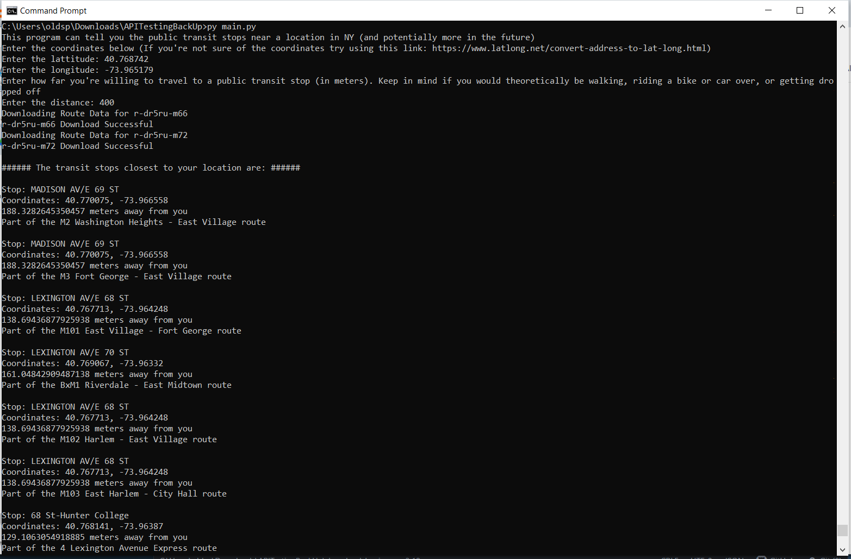
Sample result
Note that we use a radius of 400 meters for our tests. We got this number based on research that shows that 400 meters is about the average amount that people are willing to walk. (https://safety.fhwa.dot.gov/ped_bike/ped_transit/ped_transguide/ch4.cfm )
Notes:
https://replit.com/@EmileJean/Ethics-Final-Demo

Slide 9
How we decided on points to use
We needed to come up with different coordinate points to use that are relevant to our issue.
So, we jumped onto data.ny.gov to find relevant datasets related to transportation that might be useful to analyze with our program.
The following are a few different sources that we drew data/inspiration from for the purposes of our project.
Notes:
W

Slide 10
Bike requests in building
One dataset that seemed relevant to our topic was one called “Bikes in Buildings Requests”.
It’s exactly as the title suggests – data of people that requested to have their bicycles in their apartment building. It consists of a lot of different types of data, such as information on the tenant, information on the area, building information, parking information, etc. It does actually have latitude and longitude as well, but using those coordinates for every single apartment building in the dataset would be unreasonable.
This dataset made a lot of sense for us to incorporate into our project, as bike riders (especially after the pandemic), are often people who do it as an alternate way to commute in the city perhaps because the public transportation situation in their area is not good.
Notes:
W

Slide 11
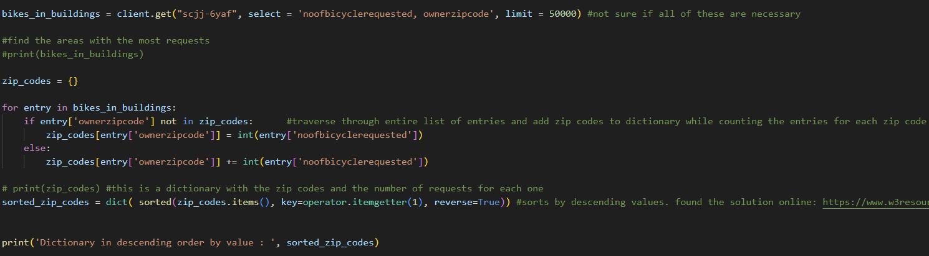
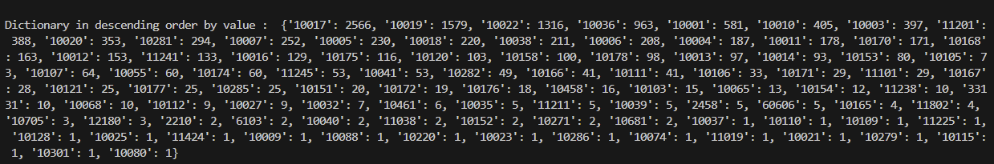
The only pieces of data we needed to look at were the number of bicycles requested, and the owner’s zip code. I then made a library for each zip code, and began adding(counting) the number of requests that corresponded with each zip code.
We only paid attention to the zipcodes with requests greater than or equal to 50.
Notes:
W

Slide 12
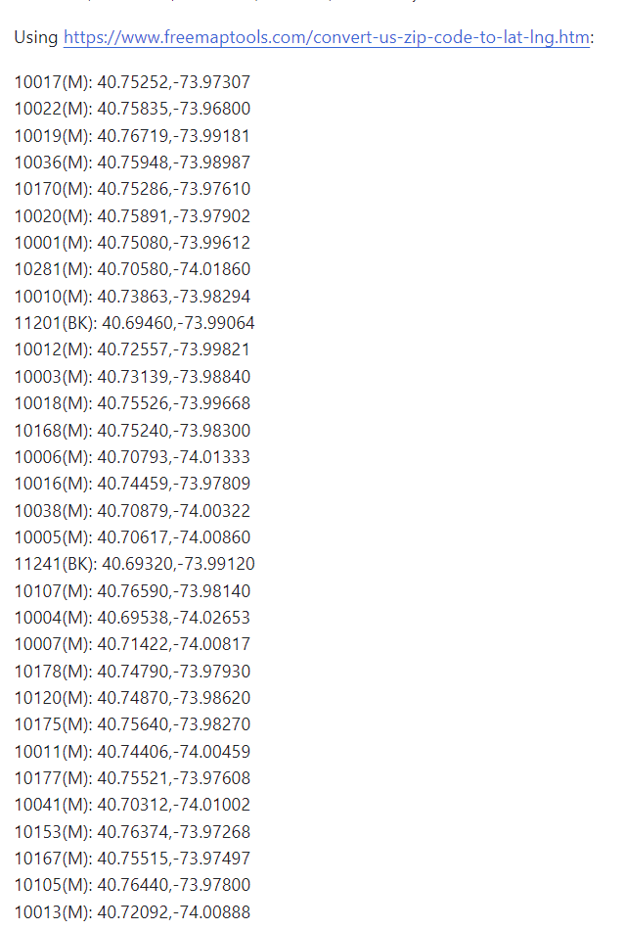
Surprisingly, or maybe not so surprisingly, the vast majority of the zip codes that we were able to derive from were actually in Manhattan. There are obviously going to be tons of public transportation opportunities in Manhattan, so it left us wondering why there were so many bikes in buildings requests in these areas.
Some potential reasons for this:
Less requests for bikes in Brooklyn and Queens as more residents there are in homes, not apartments
Those in Manhattan have better occupations, and thus more disposable income to purchase bikes
Manhattan buildings have many more residents than the average building in Brooklyn, which means there are going to be way more requests in those buildings
We ended up using the zip code data anyways with our program to see if we could learn anything else from it.
Notes:
W

Slide 13
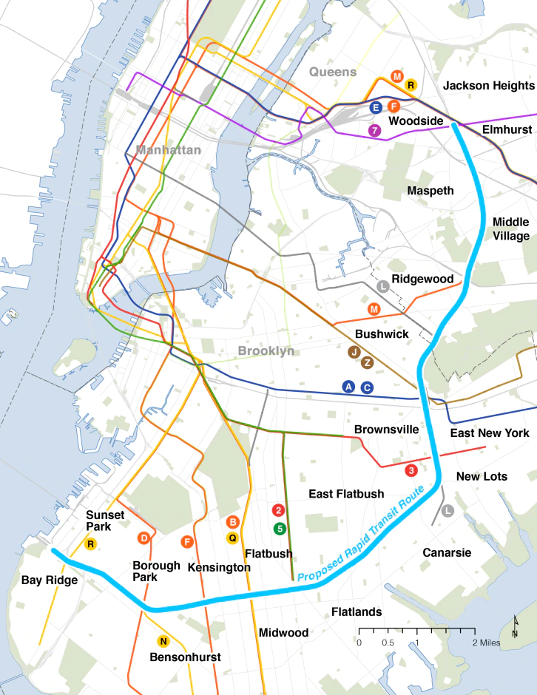
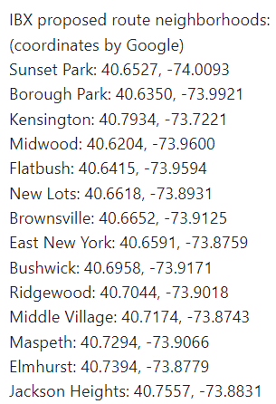
Interborough Express line
The Interborough Express line is a decades old idea that was recently revived by Governor Kathy Hochul.
The idea is to create an avenue of transportation that connects Brooklyn and Queens. It would open up the possibility of Brooklyn and Queens residents to access many more subway lines.
Clearly, there is a need in Brooklyn and Queens for more access to transportation.
We took the neighborhoods that the interborough express line would service and got the coordinates for each and put it in our program.
Notes:
W

Slide 14
Bus Service Delivered
Another interesting dataset we found was “MTA Bus Service Delivered”.
The dataset doesn’t include a whole lot of information. It calculates “service delivered” by taking the number of scheduled buses in a day for a particular route_id, and then the actual number of buses on that given day, and dividing to get a percentage.
What we can derive from this dataset are route_id’s, which are the MTA bus routes. It can tell us where the MTA is failing to meet expectations in terms of bus services.
Notes:
W

Slide 15
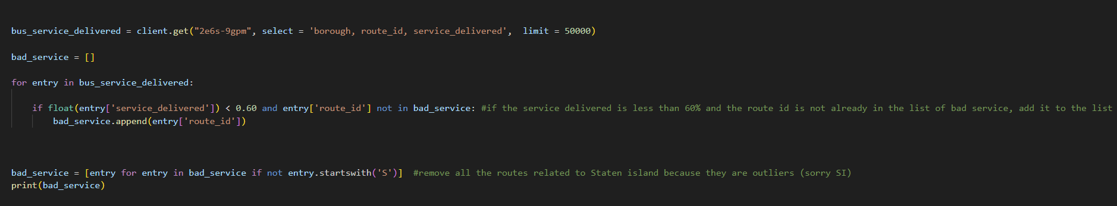
We chose to consider bus routes with less than 60% service delivered as “buses with bad service”. Note that the dataset takes data daily, meaning that it’s not as if these routes are always only providing 60% of scheduled service, but that there were times where the route did get to that point.
Either way, it describes some bus routes that we can safely say provide inconsistent/inadequate services.
Output:
We decided not to include Staten Island buses, because they were outliers that skewed the data results. As we predicted, Queens and Brooklyn were prevalent (particularly Queens).
Notes:
W

Slide 16
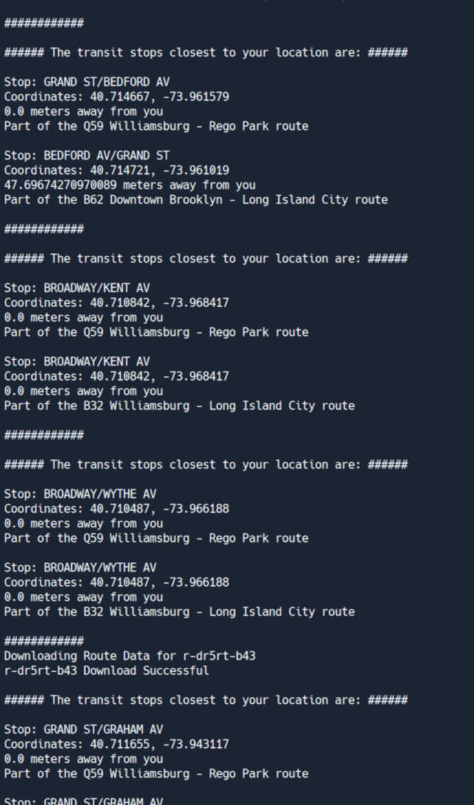
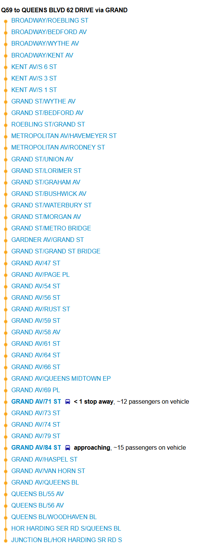
Each bus route has a lot of data points, since there are so many stops along the way. For example, the Q59 bus line has about 46 different stops on it on it’s own.
We ran code to observe the data for each individual bus stop along each of the routes. They were then put in a CSV file, just like the others.
Notes:
W

Slide 17
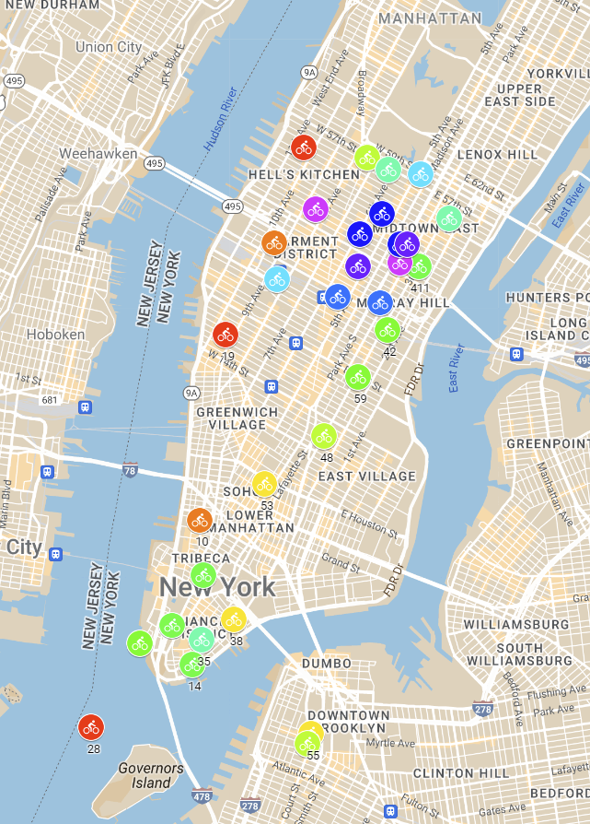
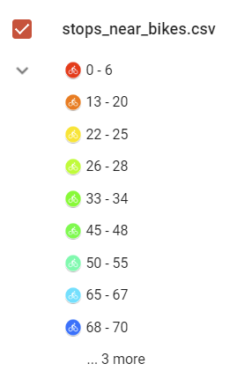
Findings
The data that we derived from our tests were put in csv files that were put in our GitHub repository. Emile found a cool way to visualize this data through Google’s “My Maps”. Take a look!
Map 1: https://www.google.com/maps/d/viewer?mid=1CWrE-j9GC4_ytR5KWOxKWTz-hrWCM5M&ll=40.727877636912936%2C-73.874315&z=11
Map 2: https://www.google.com/maps/d/viewer?mid=1E4lJ8kPh4rQKeCokaq3s-AiKZ6Y7z4g&ll=40.74654441000801%2C-73.86569999999999&z=11
Notes:
Findings – alternate between W and E, starting with E

Slide 18
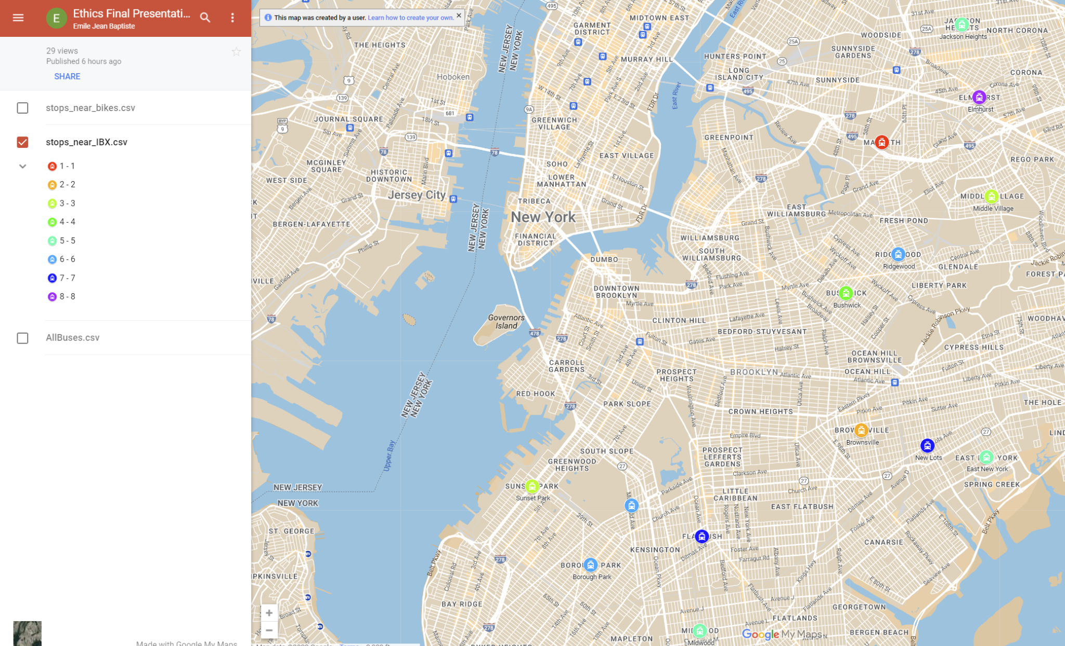
Notes:
W

Slide 19
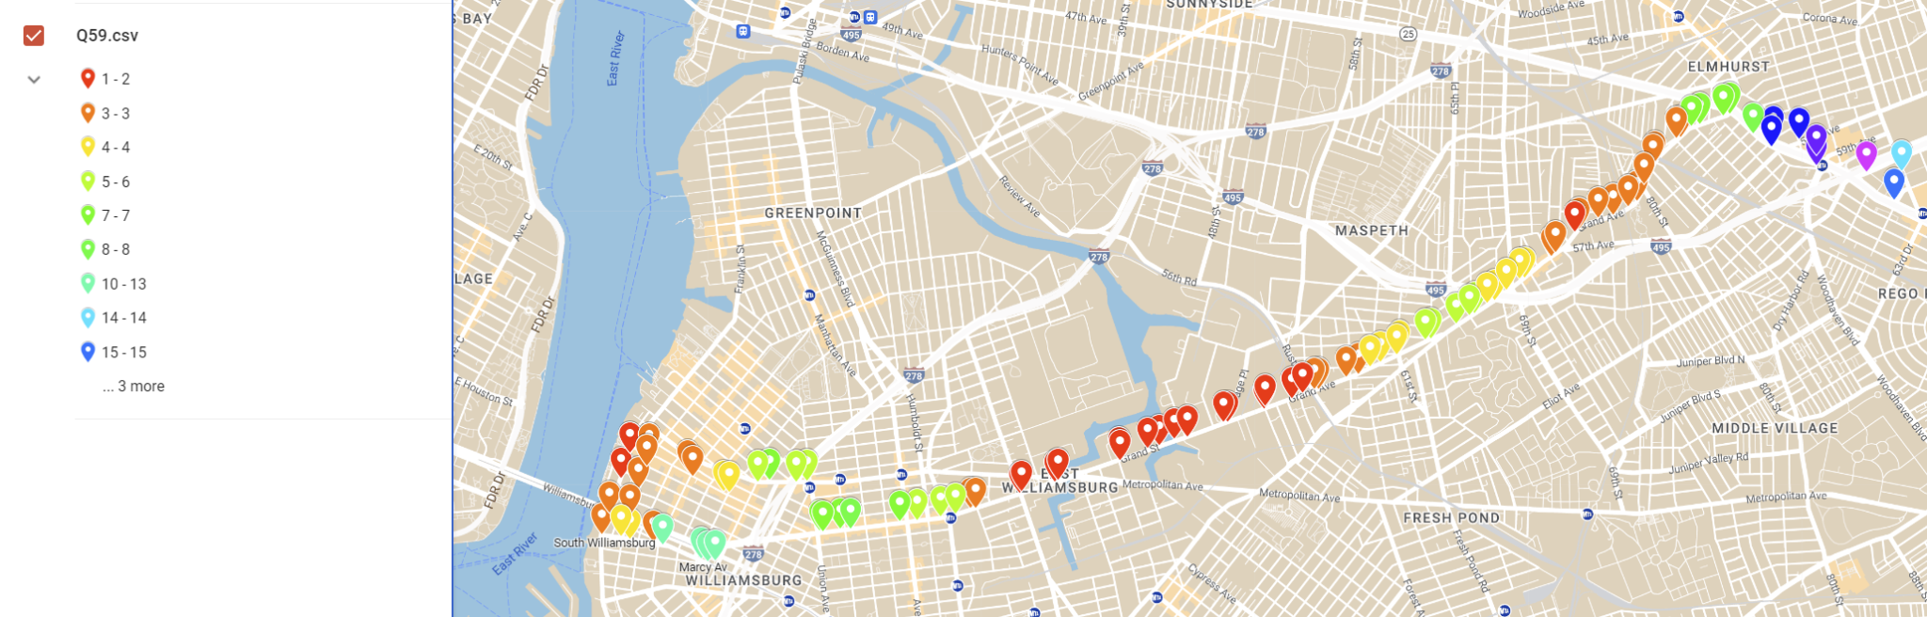
Notes:
E

Slide 20
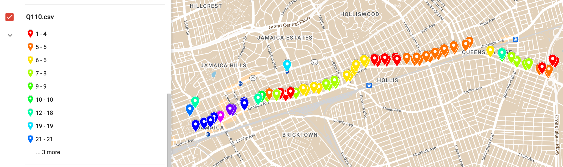
Notes:
W

Slide 21
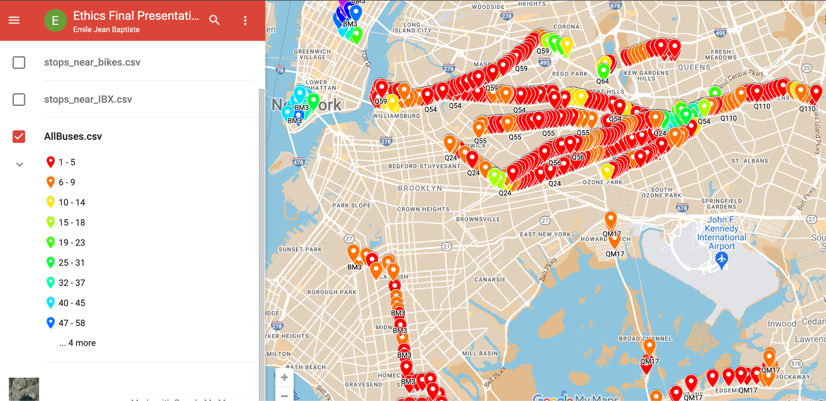
Notes:
E

Slide 22
Conclusions
The tests that we ran seemed to corroborate with our hypothesis. From the bike requests in building test, we saw that many locations in Manhattan had a variety of transportation already.
When it came to Brooklyn and Queens, however, the situation was much worse. The IBX map of our .csv results shows that many of the intended stops along the proposed IBX route do in fact have a lack of transportation options. (This supports the proposal to build the IBX!!!)
When looking at some of the bus stops data, we can see that at many times, the singular bus route has stops along the way where there are very, very few alternate modes of transportation. It describes how difficult it is to make transfers in the outer boroughs, meaning that service is not as adequate as it can be.
All this is to say that more methods of transportation would be a great benefit, especially in the outer boroughs. Our program is able to locate dry areas that could use a new bus/train route, or perhaps another bus rerouted to go through that area.
Notes:
Both

Slide 23
Other use cases/potential for more
Instead of just bus stops, we can also use the program to analyze subway stops.
While not implemented, the program has the infrastructure to support getting information about getting from one location to another using public transportation
Making the program more user friendly in terms of ease of input
Adding more information to output like if the stop is wheelchair accessible or what routes are part of the same stop/station
Factoring in the times and/or schedules certain routes are available
While we fixed some bugs affecting performance, it could be more time efficient
Notes:
E

Slide 24
References/Resources
https://www.transit.land/
https://safety.fhwa.dot.gov/ped_bike/ped_transit/ped_transguide/ch4.cfm
https://dev.socrata.com/foundry/data.cityofnewyork.us/scjj-6yaf
https://dev.socrata.com/foundry/data.ny.gov/2e6s-9gpm
https://new.mta.info/project/interborough-express
https://mymaps.google.com/
https://www.latlong.net/convert-address-to-lat-long.html

